Slide 1
Political Development of Bangladesh from 1947-1971
Ms Farhana Afroz
Senior Assistant Professor
Dept. of Social Science

Slide 2
Chronological History of Bangladesh
Early Historic Period.
The Partition of British India.
Discrimination Between East and West Pakistan.

Slide 3
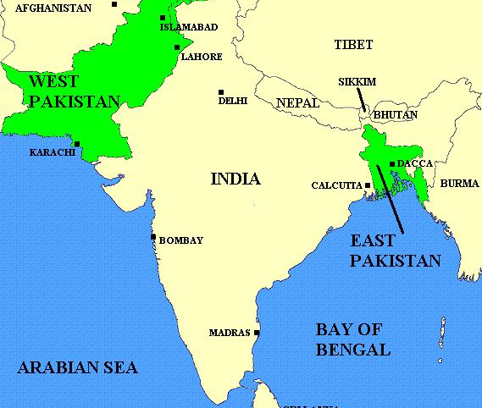
Map of Pakistan before 1971

Slide 4
Reasons behind the Conflict
Social and Political inequality.
Different Language and cultures.
Economic Exploitation.
Political discontent.

Slide 5
Major Events

Slide 6
Declaration of State Language
National Education Summit Decided to Make Urdu as a State Language.
Mohammad Ali Jinnah Declared that Urdu will be the State Language of Pakistan.

Slide 7
Language Movement
Pakistani Government Forcefully tried to Establish Urdu as a State Language.
General students Protested against this Decision and got killed in Daylight by The police Force.

Slide 8
East Bengal became East Pakistan

Slide 9
Bangla became a state language along with Urdu.

Slide 10
Presidential rule in the West Pakistan.
Governor General Gurmani declared Presidential rule in the West Pakistan.
Huseyn Shaheed Suhrawardy was forced to resign.
Chundrigar became the new Prime Minister of Pakistan.

Slide 11
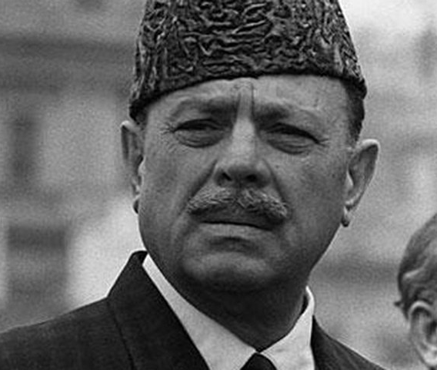
Ayub Khan captured the power
Ayub Khan captured the power on October 7.
Ayub Khan declared his cabinet.
All political parties and their activities had been banned.

Slide 12
“Basic Democracies”

Slide 13
The Split of Pakistan Muslim League
Pakistan Muslim League had been split in to two groups – Council and Convention.
Ayub Khan backed the Convention Muslim League.

Slide 14
Charges against Sheikh Mujibur Rahman
Sheikh Mujib had been charged by the government with sedition and making objectionable statements, he got one year jail term by the court, He was released later on an order of the High Court.
Ayub Khan became the President again for the second term by defeating Fatima Jinnah. By observing the election system under ‘Basic Democracy’.

Slide 15
6-Point Formula Bengalese Right to Live

Slide 16
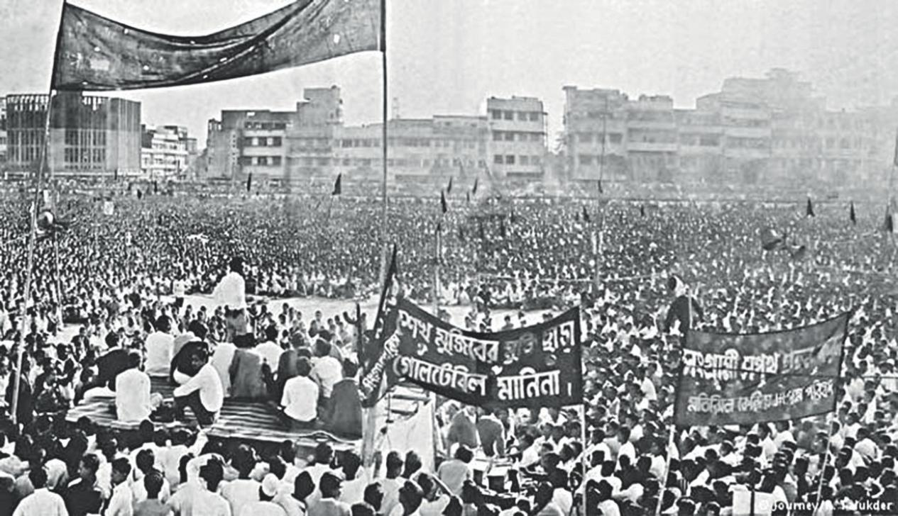
1967-1969
The relations between West Pakistan and East Pakistan were politically strained due to various issues of inequality, language, culture and a large distance of over 2000 kilometres between the two states separated by the foreign lands of India. The central power remained confined in West Pakistan, thus demand for total independent rule of East Pakistan begun. Following the Six point movement in 1966 led by Father of the Nation Sheikh Mujibur Rahman, the East Pakistan independence movement gained momentum.
The Constitution made by General Ayub in 1962 was termed as Constitutional Autocracy' and rejected by East Pakistanis.
As a result, General Upsurge was there in 1969 and he handed over power to General Yahya Khan in 25 March 1969.

Slide 17
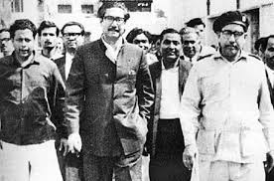
The historic Agartala Case
The plan of the Revolutionary Council
“Rashtra v. Sheikh Mujibur Rahman and others”
An inspiration to drive the Bengalis towards independence.

Slide 18
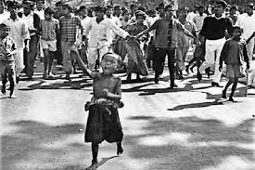
Historic Mass Upsurge of 1969
It was in line with the six points movement and against the military dictatorship of Ayub Khan.
Another vanguard of the anti-Ayub Mass Movement was the 'All Party Students Committee of Action on the basis of an 11-point program.
All these directed to the fall of Ayub's regime.
It was during the mass movement of 1969 that Bengali nationalism reached its highest point.

Slide 19
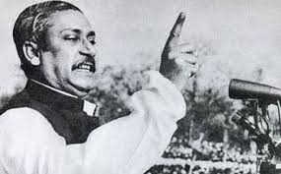
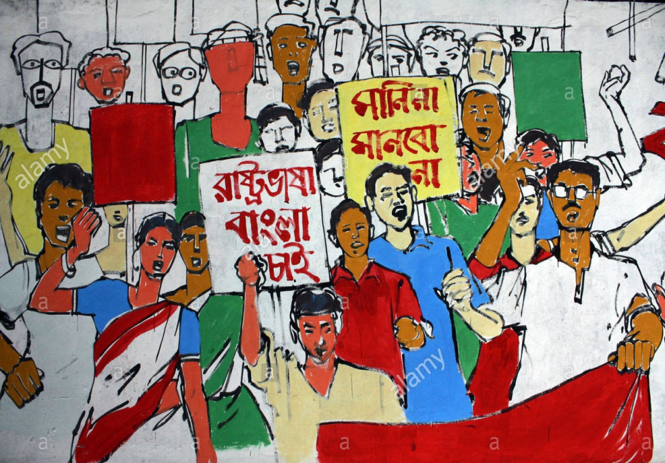
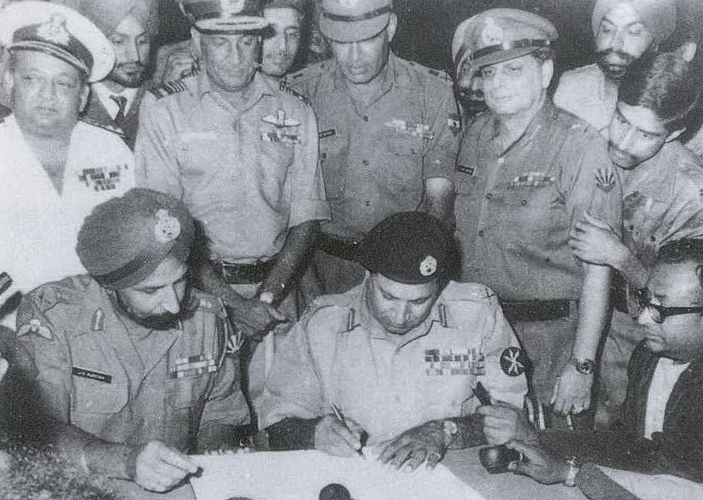
Political Development of Bangladesh From 1947-1971

Slide 20
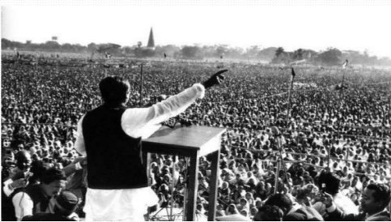
7th March of Sheikh Mojibur Rahman

Slide 21
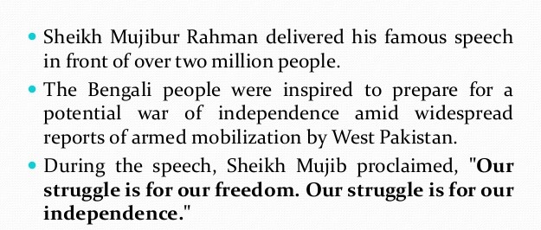
7th March of Sheikh Mojibur Rahman

Slide 22
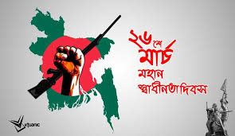

Proclamation of Bangladeshi Independence on 26th March,1971

Slide 23
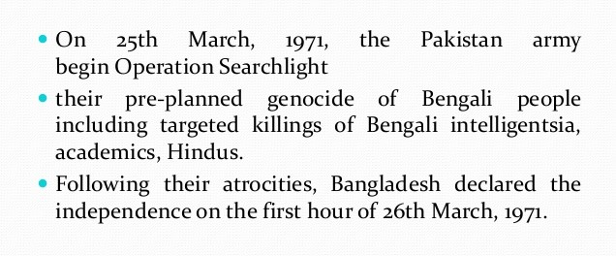
Proclamation of Bangladeshi Independence on 26th March,1971

Slide 24


Slide 25

a

Slide 26
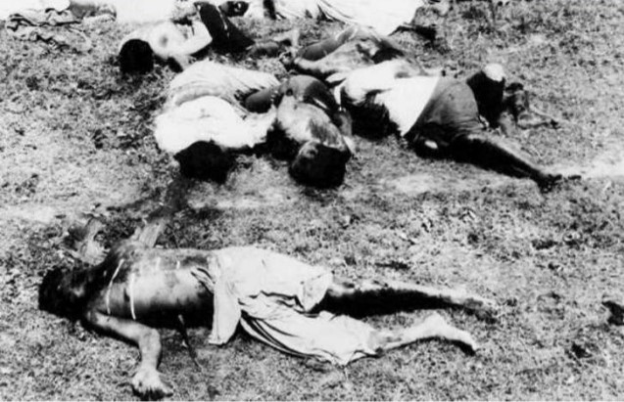
a

Slide 27
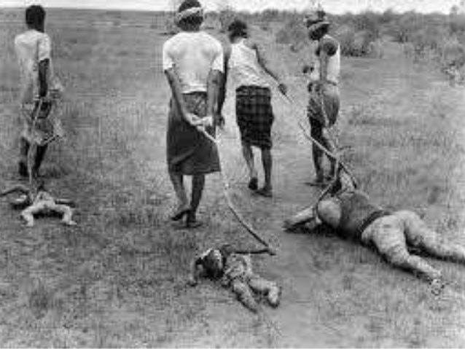
b

Slide 28
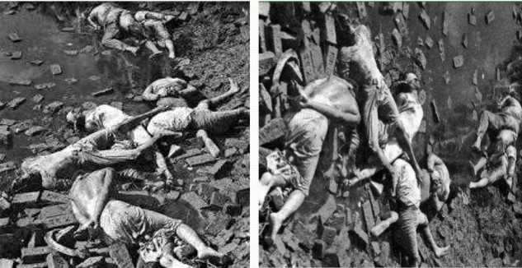

Slide 29
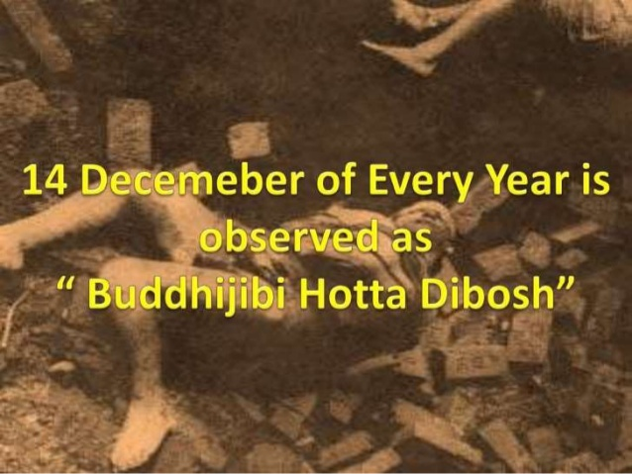

Slide 30
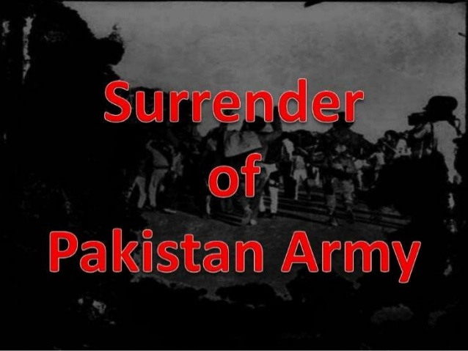

Slide 31
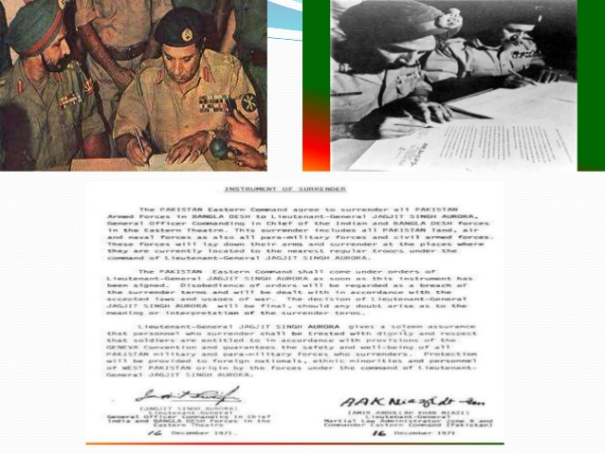

Slide 32
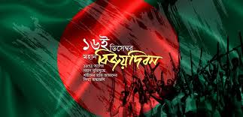
Victory Day of Bangladesh 16th December,1971

Slide 33
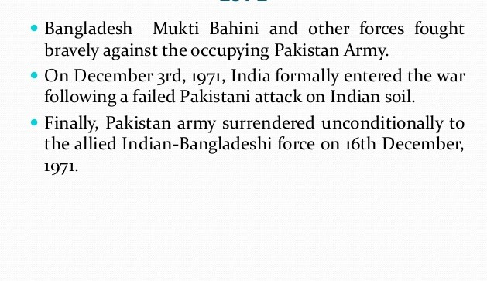
Victory Day of Bangladesh 16th December,1971

Slide 34
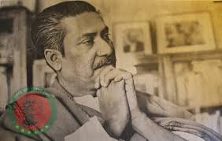
a

Slide 35
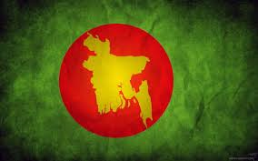

Slide 36
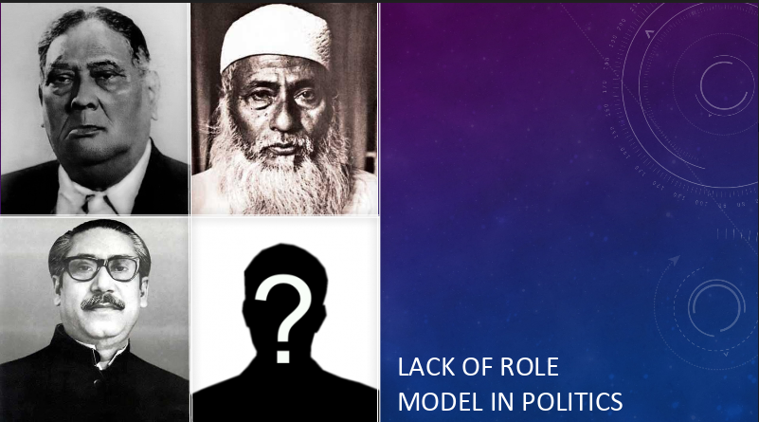
a

Slide 37


